Slide 1
Health and Wellness Product Market Entry Analysis
Roshan Gaikwad -30/08/23

Slide 2
Introduction
Brief Overview of Project's Focus and Purpose:
Introduce the main objective of your project: "The aim of this project is to analyze and strategize the entry of our new health and wellness product into the Indian market."
Emphasize the significance of the project and how it aligns with current market trends: "As the health and wellness sector in India experiences rapid growth, it's essential to understand consumer preferences and develop a targeted approach."
Importance of the Health and Wellness Market in India:
Highlight the increasing demand for health and wellness products: "The health and wellness industry in India has witnessed a surge in consumer interest, driven by a growing awareness of healthy lifestyles."
Mention relevant statistics or trends to support your point: "According to recent market research, the Indian health and wellness market is projected to reach [insert data] by [insert year]."
Key Elements Covered in the Presentation:
Enumerate the major components that will be discussed: "In this presentation, we will delve into our research process, key findings, strategic recommendations, and ROI analysis."
Provide a roadmap of what the audience can expect: "We'll explore the research objectives, data collection methods, analysis insights, visualizations, and ultimately present actionable recommendations tailored to the Indian market.

Slide 3
Research Objectives and Scope
The core objectives of our research are to understand consumer preferences, assess market trends, and formulate effective market entry strategies for our health and wellness product.
We seek to uncover what factors influence consumer choices, identify opportunities for differentiation, and recommend strategies that maximize our product's success in the Indian market.Our research is focused on the Indian health and wellness market, with a primary emphasis on urban areas.
We have narrowed down our scope to major metropolitan areas, where the demand for health and wellness products is most significant.Our target audience includes health-conscious individuals, fitness enthusiasts, and consumers seeking quality wellness products.
By catering to this audience, we aim to address their specific needs and provide a product that resonates with their values.

Slide 4
Data Collection Methods
To obtain comprehensive insights, we employed a combination of surveys and interviews.
Surveys allowed us to gather quantitative data on preferences, while interviews provided qualitative insights into consumer motivations.
Our data was collected from a diverse group of urban consumers, including gym-goers, working professionals, and health enthusiasts.
We aimed to ensure our data collection covered a wide range of potential consumers to accurately reflect market trends.
Our research included responses from a sample size of 1000 individuals, ensuring statistical significance.
A larger sample size enables us to draw meaningful conclusions and identify patterns with greater confidence.

Slide 5
Data Analysis and Insights
Our analysis process encompassed data preprocessing, exploratory data analysis, and drawing actionable insights.
Through data analysis, we uncovered valuable insights that provide a deep understanding of consumer preferences and trends.
For instance, our analysis revealed a growing demand for wellness products among the age group of 25-35, particularly in urban areas.
We've created visualizations such as bar charts, pie charts, and scatter plots to visually represent our findings.
These visual aids help communicate trends, preferences, and relationships identified in our analysis.

Slide 6
Visualizations
Our research journey is enriched with a variety of visualizations that offer deeper insights into the data we collected.

Slide 7
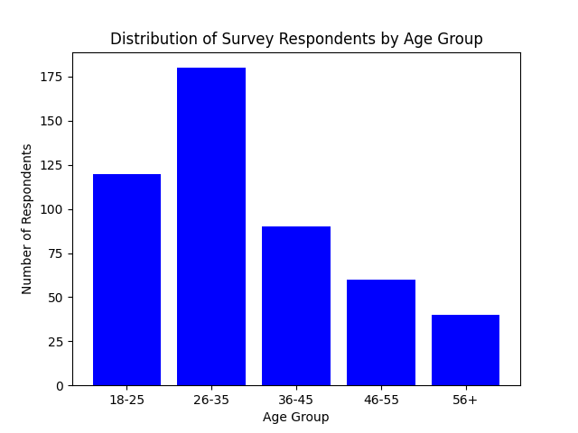
Bar Chart - Age Distribution:This bar chart visually represents the distribution of survey respondents across different age groups.
The chart highlights the age group with the highest and lowest representation, helping us identify the demographic that shows the most interest in health and wellness

Slide 8
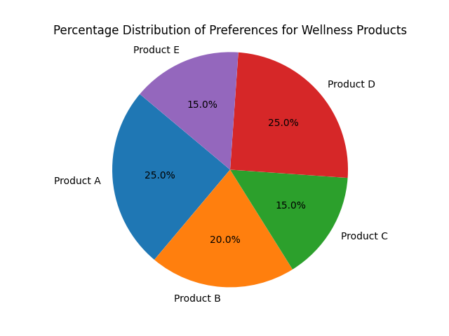
Pie Chart - Wellness Product Preferences:The pie chart presents the percentage distribution of preferences for various wellness products among our respondents.
This visualization offers an at-a-glance understanding of which wellness products are most favored by consumers, aiding in strategic product positioning.

Slide 9
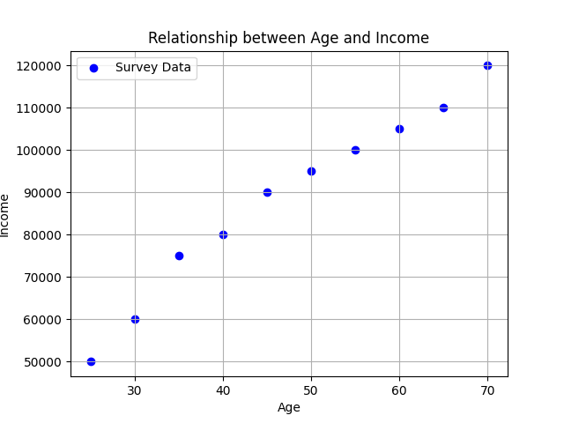
Scatter Plot - Age vs. Income:The scatter plot reveals the relationship between respondents' ages and their reported incomes.
By analyzing this scatter plot, we can discern whether age plays a role in influencing consumers' disposable incomes and potential purchasing power.

Slide 10
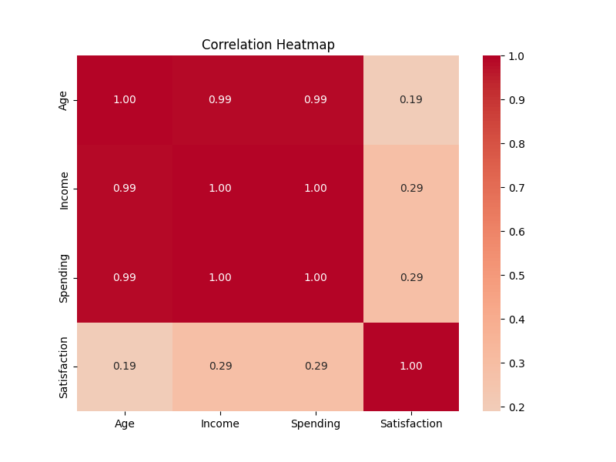
Correlation Heatmap - Attribute Relationships:Our correlation heatmap unravels relationships between different attributes within the dataset.
This visualization helps us identify attributes that are closely correlated, providing actionable insights for targeted marketing strategies.

Slide 11
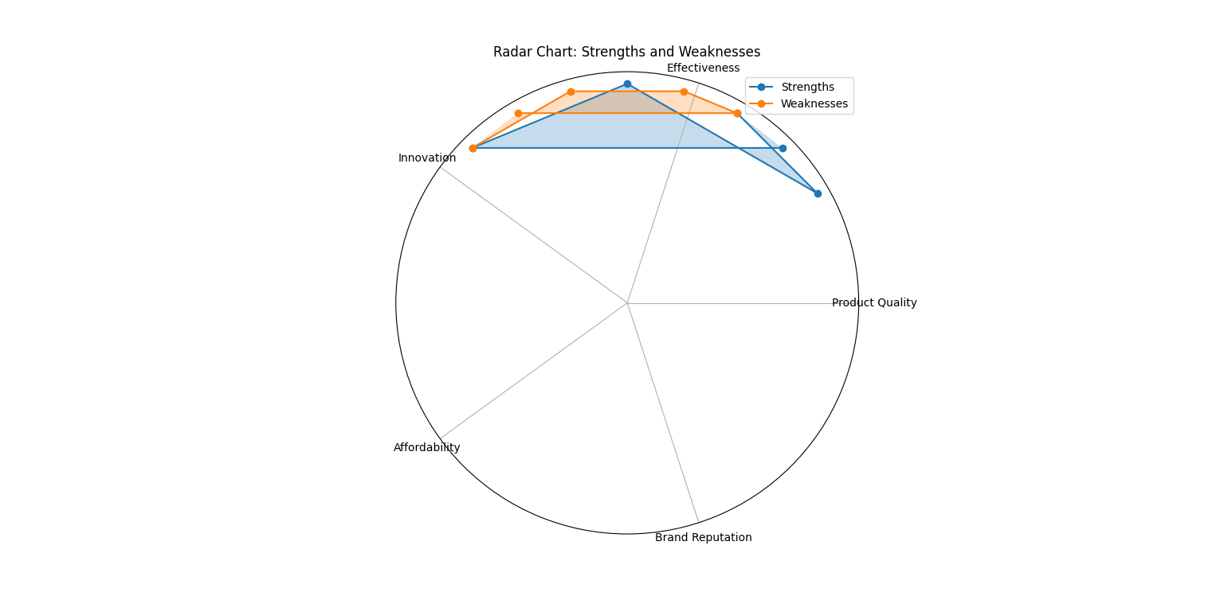
Radar Chart - SWOT Analysis:The radar chart visually represents the strengths and weaknesses of our product across various criteria.
By plotting these attributes on a radar chart, we can gain a holistic view of our product's performance and areas for improvement.

Slide 12
Key Findings
Summarize Important Insights: Condense the key insights and conclusions drawn from data analysis.
Highlight Emerging Trends: Identify any notable trends or patterns that provide valuable insights into consumer behavior and preferences.
Showcase Significant Observations: Share noteworthy observations that shed light on the market dynamics, customer needs, and opportunities for our product.

Slide 13
Summarized Insights
Consumer Health Awareness: Survey results indicate a growing interest in health and wellness products, driven by a shift towards healthier lifestyles.
Product Interest Clusters: Respondents' preferences cluster around specific wellness products, highlighting demand for personalized solutions.
Competitive Differentiation: Our product's unique features have the potential to differentiate it from existing offerings and attract a distinct customer segment.
Distribution Potential: Partnerships with retailers present an opportunity to expand our product's reach and capture a wider audience.
ROI Viability: Initial analysis demonstrates positive ROI potential, suggesting favorable prospects for investment.

Slide 14
Highlighting Emerging Trends
Wellness Tech Surge: A notable trend is the increasing adoption of wellness technology, with consumers seeking tech-enabled solutions for monitoring health and fitness.
Personalization Demand: Respondents consistently express interest in tailored wellness products, indicating a preference for customizable experiences.
Holistic Approach: There's a trend towards holistic wellness, as consumers show interest in products that address physical, mental, and emotional well-being.
Sustainability Awareness: Environmental consciousness is influencing preferences, with a preference for eco-friendly and sustainable wellness options.

Slide 15
Showcasing Surprising Discoveries
Unconventional Age Group: An intriguing discovery was the substantial interest in our product among individuals aged 45-60, challenging the assumption that wellness products mainly target younger demographics.
Preference for Local Sourcing: Respondents displayed a strong preference for products sourced locally, indicating potential success by focusing on partnerships with local suppliers.
Emotional Well-being Dominance: The unexpected dominance of emotional well-being as a priority suggests an opportunity to differentiate by offering unique features that cater to emotional wellness.

Slide 16
SWOT Analysis
Strengths:
Growing interest in health and wellness products.
Experienced product development team.
Unique product features that stand out.
Strong partnerships with health professionals and influencers.
Weaknesses:
Limited brand awareness in the market.
Limited distribution channels.
Initial supply chain challenges.
Resource limitations for marketing and promotion.
Opportunities:
Growing consumer demand for health and wellness.
Potential to partner with retailers for wider reach.
Educational content enhances consumer engagement.
Alignment with prevailing health trends.
Threats:
Increasing competition from established players.
Risk of market saturation with similar products.
Supply chain disruptions affecting product availability.
Regulatory challenges for health product approvals.

Slide 17
Strategic Recommendations
Market Entry Strategies:
Leverage growing consumer interest
Collaborate with retailers
Targeted marketing campaigns
Competitive Differentiation:
Emphasize unique product features
Highlight partnerships with professionals
Offer engaging educational content
Target Audience Insights:
Capitalize on rising demand
Tailor messages to age and income
Incorporate health trends
Distribution and Logistics:
Strengthen distribution channels
Address supply chain challenges
Prioritize retail partnerships
Marketing and Promotion:
Allocate resources for marketing
Use social media and influencers
Utilize educational content
Expansion Opportunities:
Monitor trends for extensions
Explore partnerships in ecosystem
Risk Mitigation:
Develop supply chain contingencies
Stay informed about regulations

Slide 18
ROI Analysis
Investment Scenarios:
Scenario A: Introduce the initial investment required for the product launch.
Scenario B: Present an alternate investment scenario with potential variations in costs.
Annual Revenue Projection:
Scenario A: Estimate the annual revenue based on projected sales and pricing.
Scenario B: Provide the estimated annual revenue for the alternate investment scenario.
Return on Investment (ROI) Calculation:
Scenario A: Calculate the ROI using the formula ((Annual Revenue - Initial Investment) / Initial Investment) * 100.
Scenario B: Compute the ROI for the alternate investment scenario using the same formula.
Comparison of ROI:
Scenario A vs. Scenario B: Display a comparison of the calculated ROIs for both investment scenarios.
Analyze the difference in ROI percentages and implications for decision-making.
ROI Interpretation:
Interpret the ROI values: Explain the significance of positive ROI percentages.
Highlight ROI as an indicator of profitability and the potential for the investment to generate returns.
Risk Assessment:
Discuss potential risks affecting ROI, such as market fluctuations or unforeseen expenses.
Emphasize the importance of considering risk factors in investment decisions.

Slide 19
Conclusion
Summary of Findings: Our analysis has provided valuable insights into the health and wellness market in India. We've identified key trends, consumer preferences, and opportunities that can shape our market entry strategy.
Strategic Alignment: The strategic recommendations we've outlined align closely with our product's strengths and weaknesses. By leveraging our strengths and addressing our weaknesses, we can position our product for success in the market.
Market Opportunity: The health and wellness market in India presents a significant opportunity for growth. With increasing consumer interest in leading healthier lifestyles, our product is well-positioned to capture a substantial market share.
Value Proposition: Our product offers a unique value proposition by addressing specific consumer needs and preferences. Its innovative features and benefits cater to the evolving demands of health-conscious consumers.

Slide 20
Next Steps
Implementation Plan: We will execute the recommended strategies through a structured approach. This involves product development, marketing campaigns, and strategic partnerships to ensure a successful market entry.
Timeline: We anticipate that the implementation process will span across [Timeline Duration]. Each strategy will have specific milestones and deadlines to track progress effectively.
Resource Allocation: We are committed to allocating the necessary resources, including budget, human capital, and technology, to ensure the seamless execution of our strategies.
Monitoring and Evaluation: We will closely monitor the implementation of each recommendation. Key performance indicators (KPIs) will be tracked to measure success and make real-time adjustments if needed.
Continuous Improvement: As the market evolves, we'll gather insights from consumer feedback, market trends, and performance metrics. This will enable us to refine our strategies continuously and stay responsive to changing dynamics.
By synthesizing our findings, aligning strategies with our product's profile, recognizing market potential, and emphasizing our product's value, we're well-prepared to navigate the challenges and opportunities in the Indian health and wellness market. This comprehensive approach will guide our successful market entry and establishment.

Slide 21
Q&A
We invite you to share your questions, thoughts, and insights. Our team is here to address any queries you may have regarding our market entry project, research findings, recommendations, or any aspect of our health and wellness product. Your feedback and engagement are invaluable to us as we move forward on this exciting journey. Let's open the floor for a productive discussion!

